Slide 1
How to fail at building websites
[and a lot of other things]
by
Ian Lintner

Slide 2
http://goo.gl/oFCahL
Url of the Presentation Links & Slideshare

Slide 3

"The Presentation You Are About To See Is True.
The Names Have Been Changed To Protect The Innocent"

Slide 4
“Success represents the 1% of your work which results from the 99% that is called failure.”
– Soichiro Honda

Slide 5
Failure
Why do web projects fail?
Why does failure happen?
How do we mitigate failure?
How do these apply to web projects?

Slide 6
Caveat
Failure is relative to the observer.
You may look at something and think it is an absolute disaster, where some one else may view it as a first class win.
http://www.lingscars.com/

Slide 7
Why are websites so prone to failure?

Slide 8
Websites are at the intersection of design, communication and technology.

Slide 10
Why do web projects fail?
Unrealistic or unarticulated project goals (Expectations)
Inaccurate estimates of needed resources (Human Error)
Badly defined system requirements (Communication)
Poor reporting of the project's status (Communication)
Unmanaged risks (Design)
Poor communication among customers, developers, and users (Communication)

Slide 11
continued…
Use of immature technology (Design)
Inability to handle the project's complexity (Leadership)
Poor project management (Leadership)
Stakeholder politics (Communication)
Commercial pressures (Expectations)
Sloppy development practices (Human Error)

Slide 12
Types of failure in web design & development
Communication
Expectations
Leadership
Cultural
Design & Planning
Human Error

Slide 13
Anti-Social
Committees
Dictators
Toxic Managers & Co-Workers
Office / Department Politics

Slide 14

Psychology of Failure

Slide 15
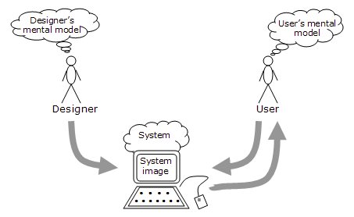
We use mental models to understand our world.

Slide 16
Mental models are flexible and therefore can adjust for failure.

Slide 17
Pattern Recognition
Our Brain is Wired to Recognize Patterns

Slide 18

False Patterns
Dark Side of The Moon & Wizard of Oz
http://vimeo.com/46671351
Abriged Version Highlighting Synchronicities
http://www.youtube.com/watch?v=MDz2cNL1vuM

Slide 19
Type 1 vs Type 2 Errors

Slide 20


Type 1 Error: False Positive
Type 2 Error: False Negative

Slide 21
Adaptive Bias
We are hardwired to reduce the cost not the number of cognitive errors.
The costs of a "false positive" or "false negative" error dramatically outweighs the cost of the alternative type of error
The greatest effect is seen when
When the decision process is ambiguous
The decision is related to survival of the fittest e.g. life vs death, reproduction

Slide 22
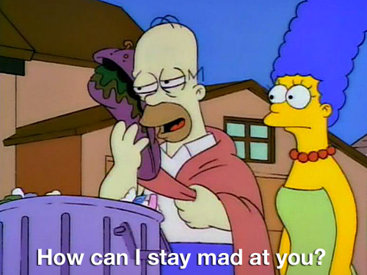
Is the sandwich safe to eat?
Type 1 error
Homer doesn’t eat the sandwich and doesn’t get sick, but he misses out on eating the sandwich.
Type 2 error
Homer eats the sandwich and maybe he get sick, but he does not miss out on eating the sandwhich.

Slide 23
Cognitive Bias
A cognitive bias happens when someone makes a bad choice that they think is a good choice based on beliefs or cognitive wiring in our brain.

Slide 24
Types of Cognitive Bias
There are over 100 identified cognitive biases
http://rationalwiki.org/wiki/List_of_cognitive_biases

Slide 25
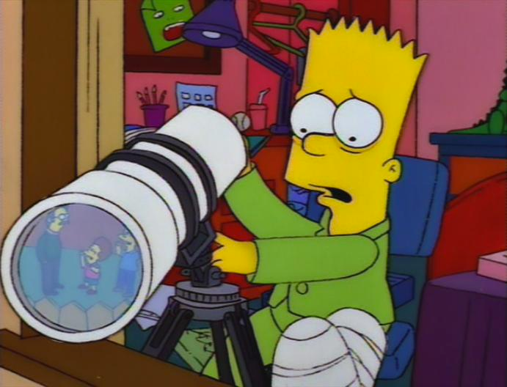
Confirmation Bias
Confirmation bias is the tendency of people to favor information that confirms their beliefs or hypotheses. People display this bias when they gather or remember information selectively, or when they interpret it in a biased way. The effect is stronger for emotionally charged issues and for deeply entrenched beliefs.

Slide 26
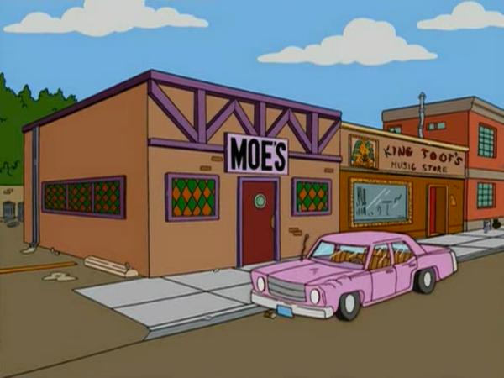
Status-Quo Bias
We like to stick to our routines, political parties, and our favorite meals at restaurants. Part of the perniciousness of this bias is the unwarranted assumption that another choice will be inferior or make things worse.

Slide 27
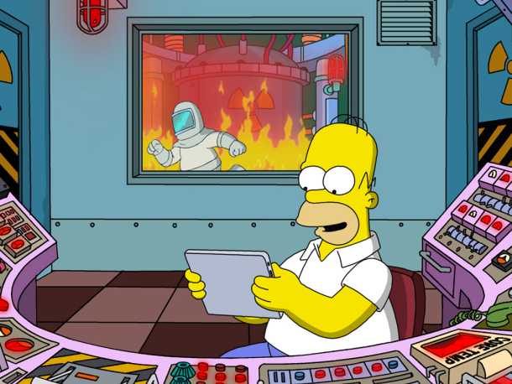
Optimism Bias
The systematic tendency to be over-optimistic about the outcome of planned actions.

Slide 28
It's About Time: Optimistic Predictions in Work and Love
13% of subjects finished their project by the time they had assigned a 50% probability level; [Best Case]
19% finished by the time assigned a 75% probability level; [Standard]
45% finished by the time of their 99% probability level. [Worst Case]
http://www.tandfonline.com/doi/abs/10.1080/14792779343000112#.U0qkGOZdVz4

Slide 29
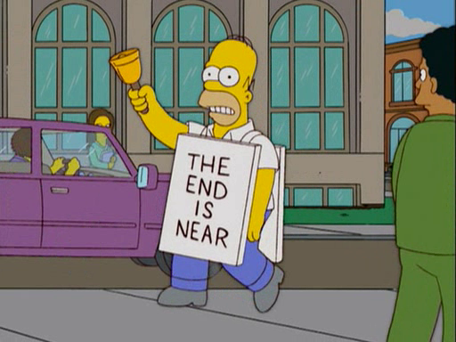
Negativity Bias
People tend to pay more attention to bad news — and it's not just because we're morbid. Social scientists theorize that it's on account of our selective attention and that, given the choice, we perceive negative news as being more important or profound.

Slide 30
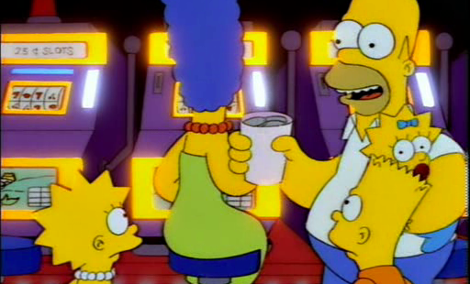
Gambler’s Fallacy
We tend to put a tremendous amount of weight on previous events, believing that they'll somehow influence future outcomes.

Slide 31
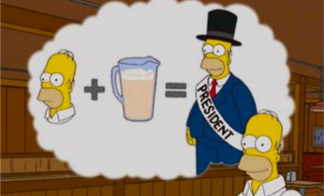
Illusory correlation
Inaccurately perceiving a relationship between two unrelated events.

Slide 32
Mitigating Bias & Error

Slide 33
Learning & error correction rely on feedback loops.

Slide 34
Scientific Method
Scientific method refers to ways to investigate phenomena, get new knowledge, correct errors and mistakes, and test theories.

Slide 35
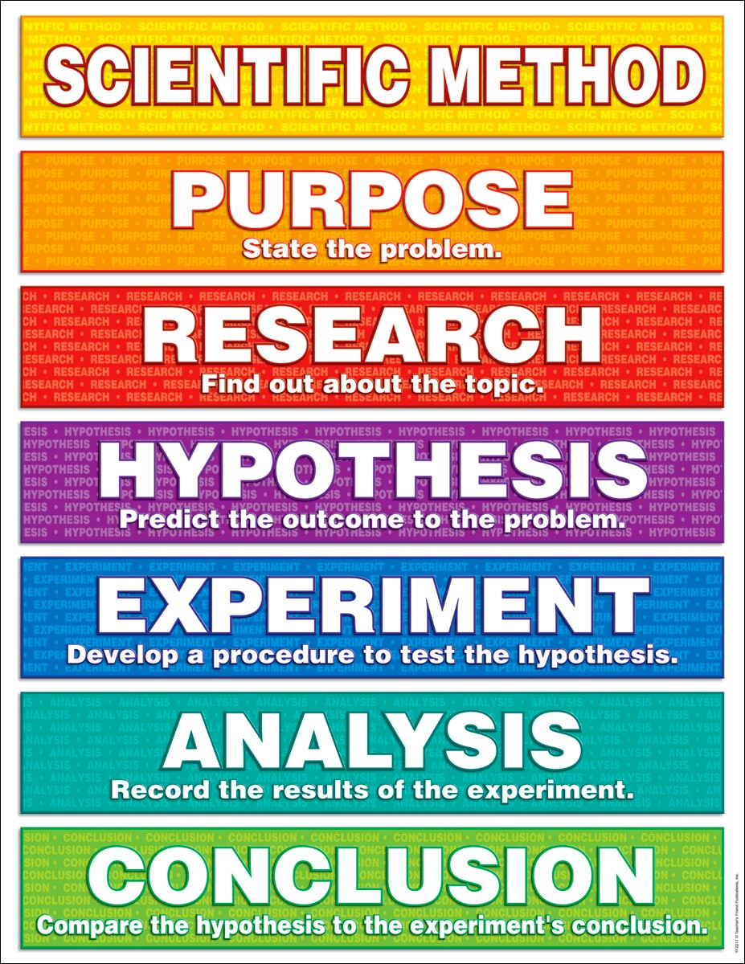

Slide 36
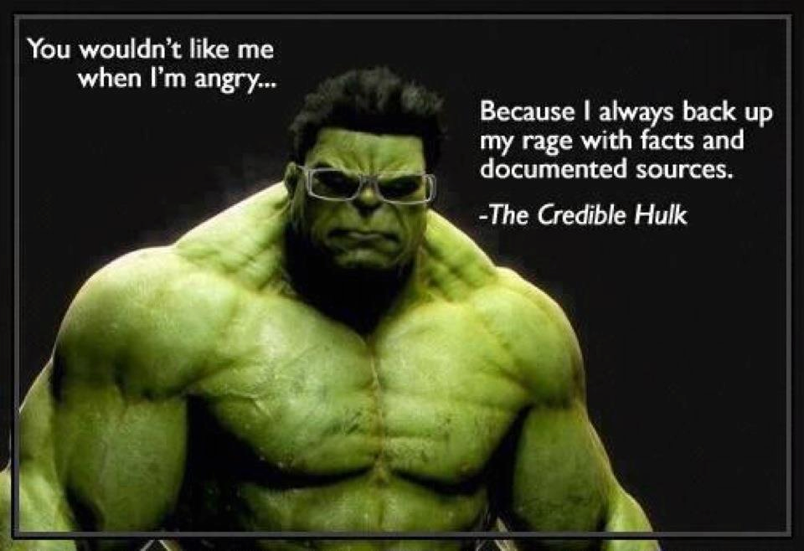

Slide 37
The scientific method is designed to be self correcting and remove bias and conjecture.

Slide 38
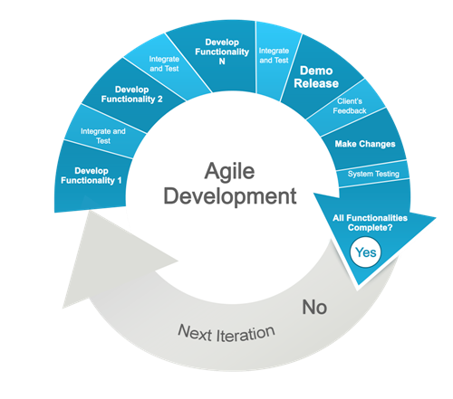
The iteration is a feed back loop

Slide 39
Error Correction mechanisms in Agile.

Slide 40
Continuos Improvement
“Kaizen”
Identify sub-optimal processes & waste.
Remove waste via small incremental change rather than radical changes.
Improvement comes from inside.
Change can be made to improve the output or the process as needed.
Self & Team Introspection and reflection.

Slide 41
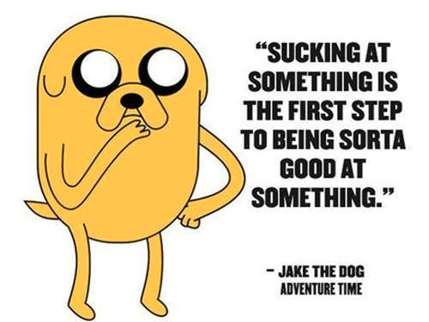

Slide 42
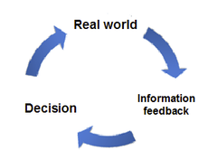
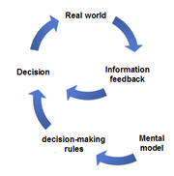
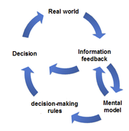
Good
Better
Best
Types of Feedback
and Learning

Slide 43
The retrospective.
Stop doing?
Keep doing?
Start doing?
End result is changing expectations and the workflow to handle change.

Slide 44
Communication Points
Multiple Times / Day
Ad-hoc communication e.g. hallway meeting, chat, hangouts etc
Every Day
Stand up / check in
1-2 time / iteration
Demos
Status meetings
Less frequently
High Level Project planning
Major Course Corrections

Slide 45
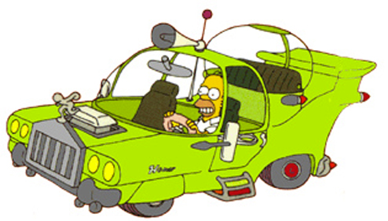
Criticisms of Agile
Lack of high level design
Many small iterations
Scope Creep is embraced since customers / owners drive output
Difficult to provide time estimates, but agile assumes estimates are flawed, but business want estimates.

Slide 46
Website Process Do’s and Don’ts

Slide 47
Project Kickoff
Don’t invite every one to the first meeting
Don’t assume every one knows who does what
Treat the kick off meeting as just another project
Do define general roles and hats with the core do’ers first
Do make a rough communication plan or responsibility wiki page
Do start building support & passion for the project from the do’ers

Slide 48
Planning
Don’t gloss over the big picture and how the project fit’s into the business strategy
Don’t ignore the end users.
Don’t plan with out a basic set of data and make conjectures
Don’t use research for user’s needs, but rather just business / marketing objectives
Do define the business goals and how a project will benefit the organization.
Do survey or have conversations with current or expected users.
Do Research, Research, Research and analyze.
Do reconcile research with user’s needs

Slide 49
Design
Don’t try to do design in one big ball or huge process
Don’t let visual design lead IA
Don’t discount Wireframes
Don’t focus entirely on Design & Branding
Don’t start each new page design from scratch
Do divide each part of the design into separate actions.
Information Architecture
Wireframes
Design & Branding
Reconcile these phases if necessary
Do these steps in parallel
Do Create a digital style guide once the design is viable.

Slide 50
Build
Don’t wait until planning is on 100% done.
Don’t put more emphasis on the build than the design
Don’t rely on infrequent milestones and status updates to show the product
Do start the website build as soon as the design & function is minimally viable.
Do try to equalize the design and planning velocity to match or outpace build velocity
Do demo every iteration whether internal or external to confirm the planning & design.

Slide 51
Deploy
Don’t deploy infrequently
Don’t focus on making deployments easier
Don’t let the technical team drive the deployment
Do deploy as soon as features are ready - continuous deployments
Do automate as many things as possible to eliminate human error - even if there is not a time ROI
Do let the product / business owners drive feature deployments when ready

Slide 52
Embrace it
Embrace change & Redefine failure
Communicate more often than you think is necessary
Check your assumptions against the data — feedback.
Look for errors & bias in your mental model and conclusions.
Make small changes to your workflow using feedback loops.

Slide 53

Thank You

Slide 54
Sources
http://spectrum.ieee.org/computing/software/why-software-fails
http://rationalwiki.org/wiki/List_of_cognitive_biases
http://en.wikipedia.org/wiki/Type_I_and_type_II_errors
http://en.wikipedia.org/wiki/Agile_software_development
http://en.wikipedia.org/wiki/Mental_model

